Slide 1


“Capstone Project”
Submitted by:
Submission type : Individual
Name: Tushar Bhosale
Batch :
LMS Id :
Program : API development program
Date: 17/11/1999

Slide 2

Table of contents
Introduction
Project Overview
Architecture Design
Back-end Development
Testing
Deployment
Conclusion
Future Work
References
Appendices

Slide 3
Introduction
The Project simply demands for Employee details like Employee Name, Date of birth and Employee ID When we provide the employee ID to the application .The project also make sure that the date of birth is displayed in Encrypted format and only Client can access the date . The application also make sure of request security by secure protocol

Slide 4
Project Overview
Problem statement: the project aims to provide a web-based employee management system that allows organizations to efficiently manage their employees' information.
Objectives: providing a user-friendly interface for managing employee information, ensuring the security of the data, and making the system scalable and flexible.
Scope: the system will allow users to view employee information search for employees based on criteria.
Target audience: the system can be targeted at HR departments in organizations of all sizes.
Benefits: increased efficiency, improved accuracy, and reduced workload for HR personnel.

Slide 5
Architecture Design
High-level architecture: Provide an overview of the high-level architecture of the system, including the components, layers, and modules. You can use diagrams to explain the architecture.
Technologies used: the system is built using Spring Boot, Java, and Hibernate.
Data storage: The application uses MySql
Security: the authentication and authorization mechanisms used, and the data encryption methods.
Integration with other systems: If the system is integrated with client systems, using REST API

Slide 6
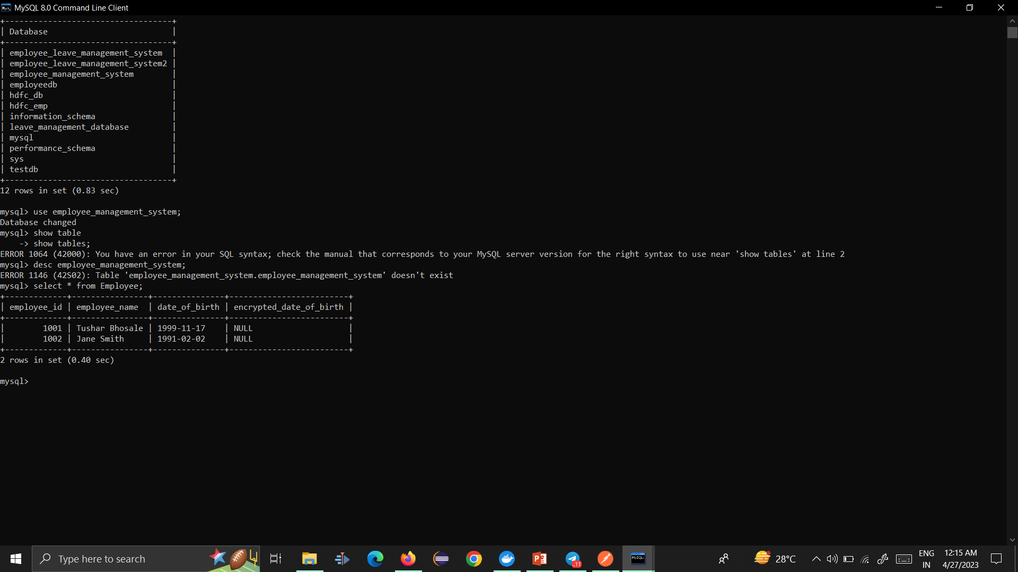
Back-end Development

Slide 7
Back-end Development
Programming languages and frameworks: the system is built using Java and Spring Boot.
Database design: examples of the code, including the SQL queries, and the ORM (Object-Relational Mapping) code.
API development: examples of the code, including the REST API endpoints, request and response structures
Testing: unit testing, integration testing. the testing frameworks and tools used, such as JUnit .
Challenges and solutions: mentioning issues related to performance, security, and deployment.

Slide 8
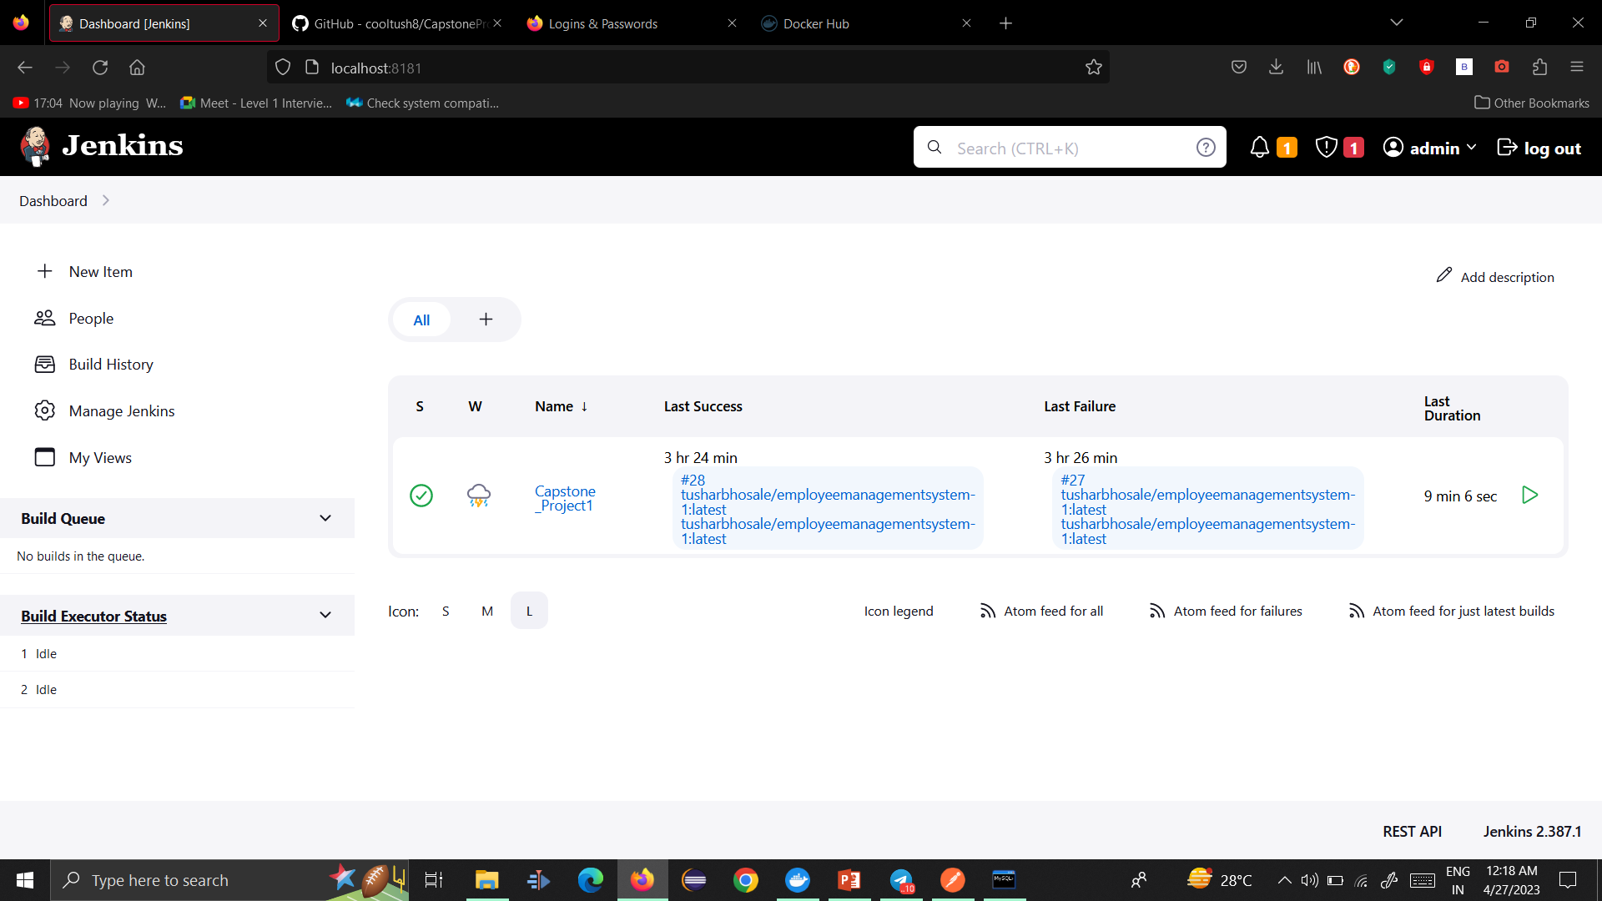
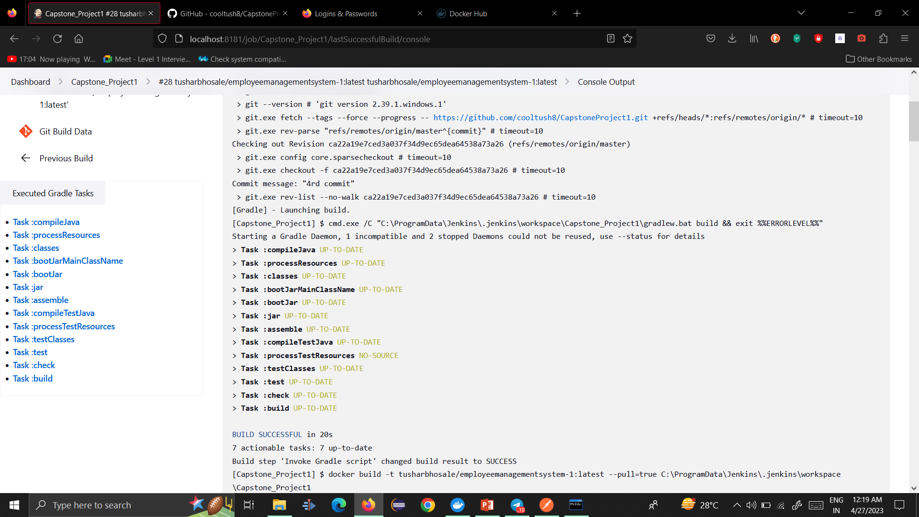
Integration and Testing
Junit Jenkins dashboard, console,

Slide 9
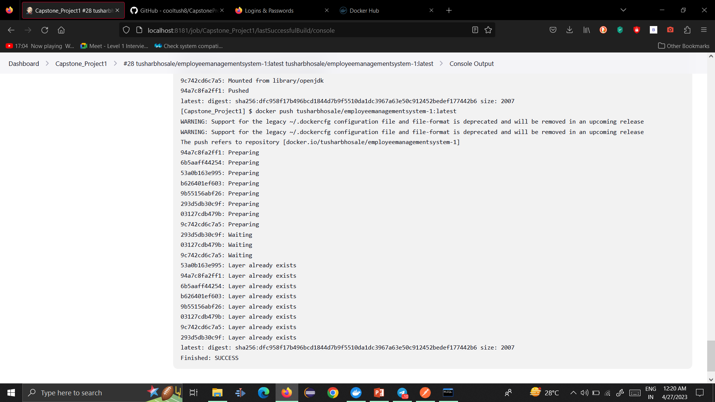
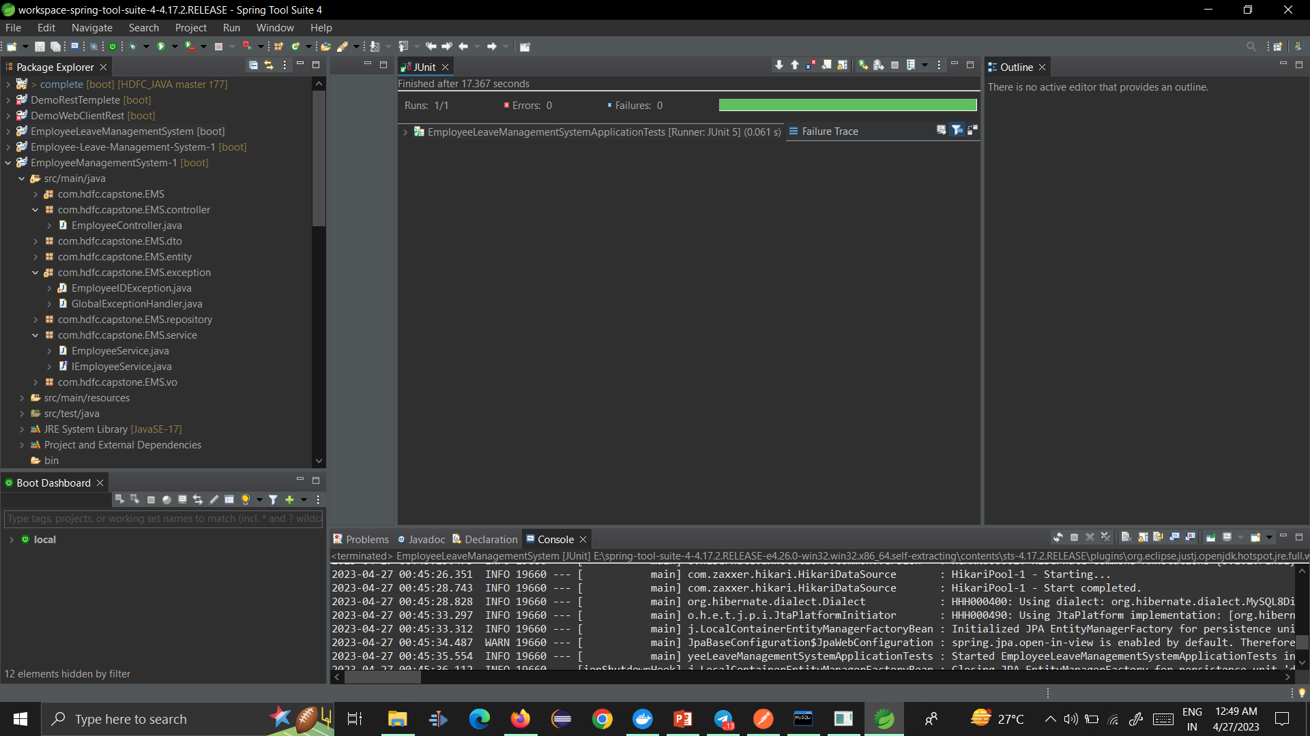
Integration and Testing

Slide 10
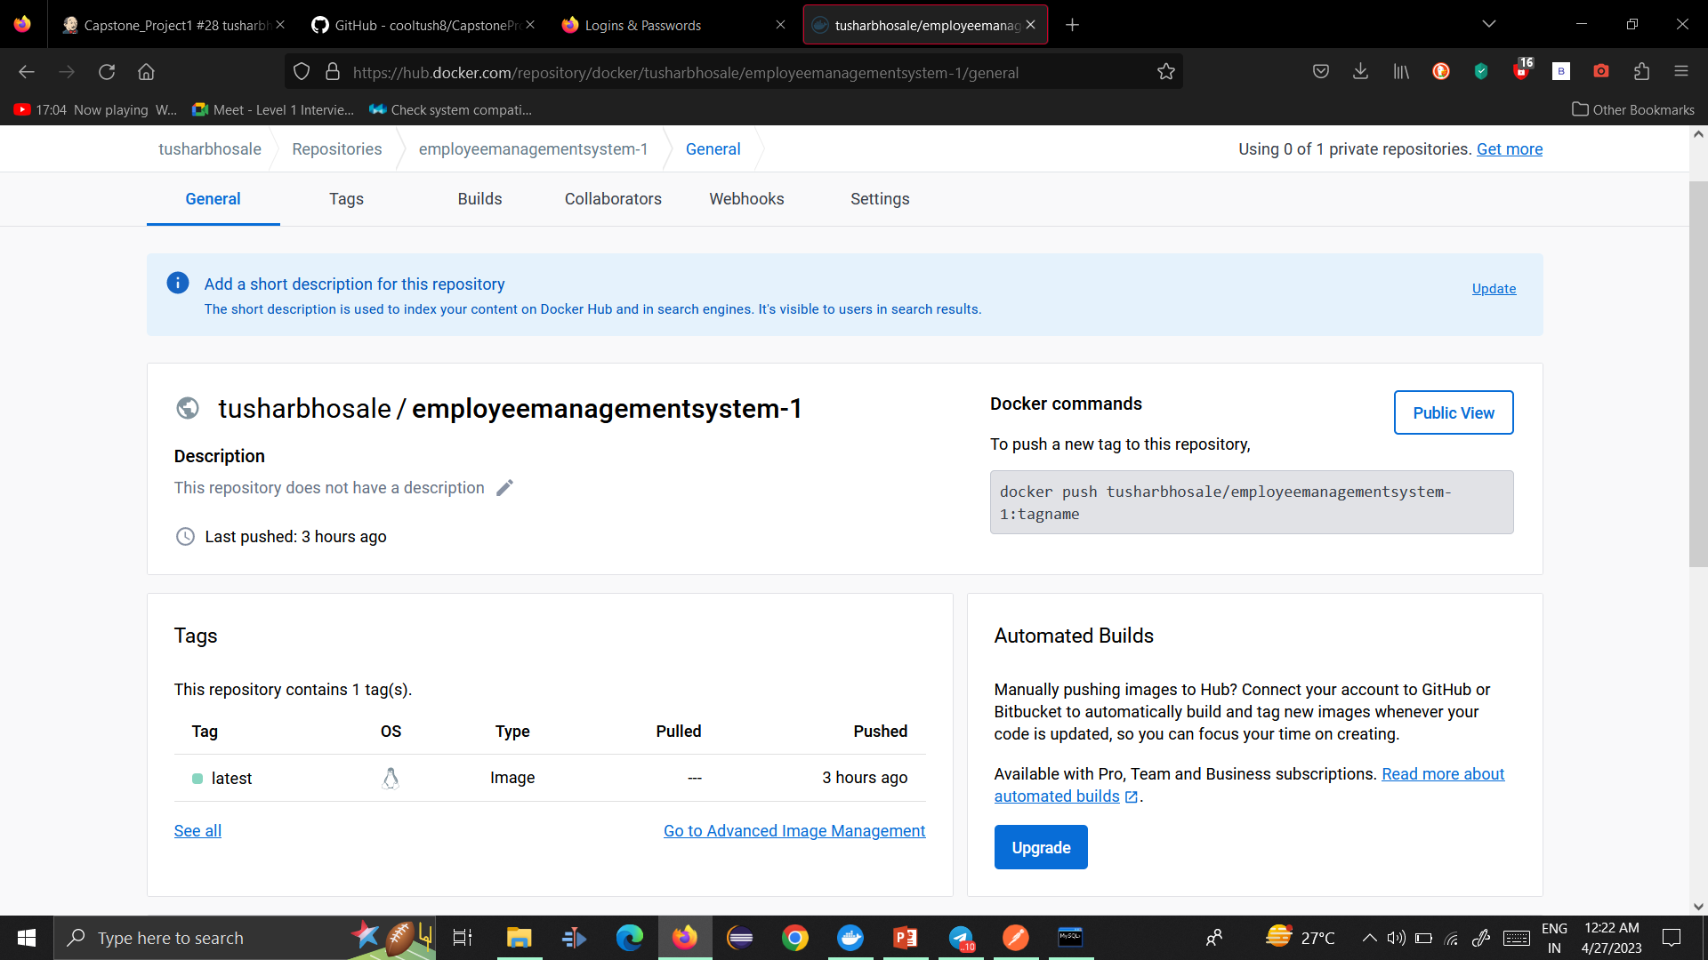
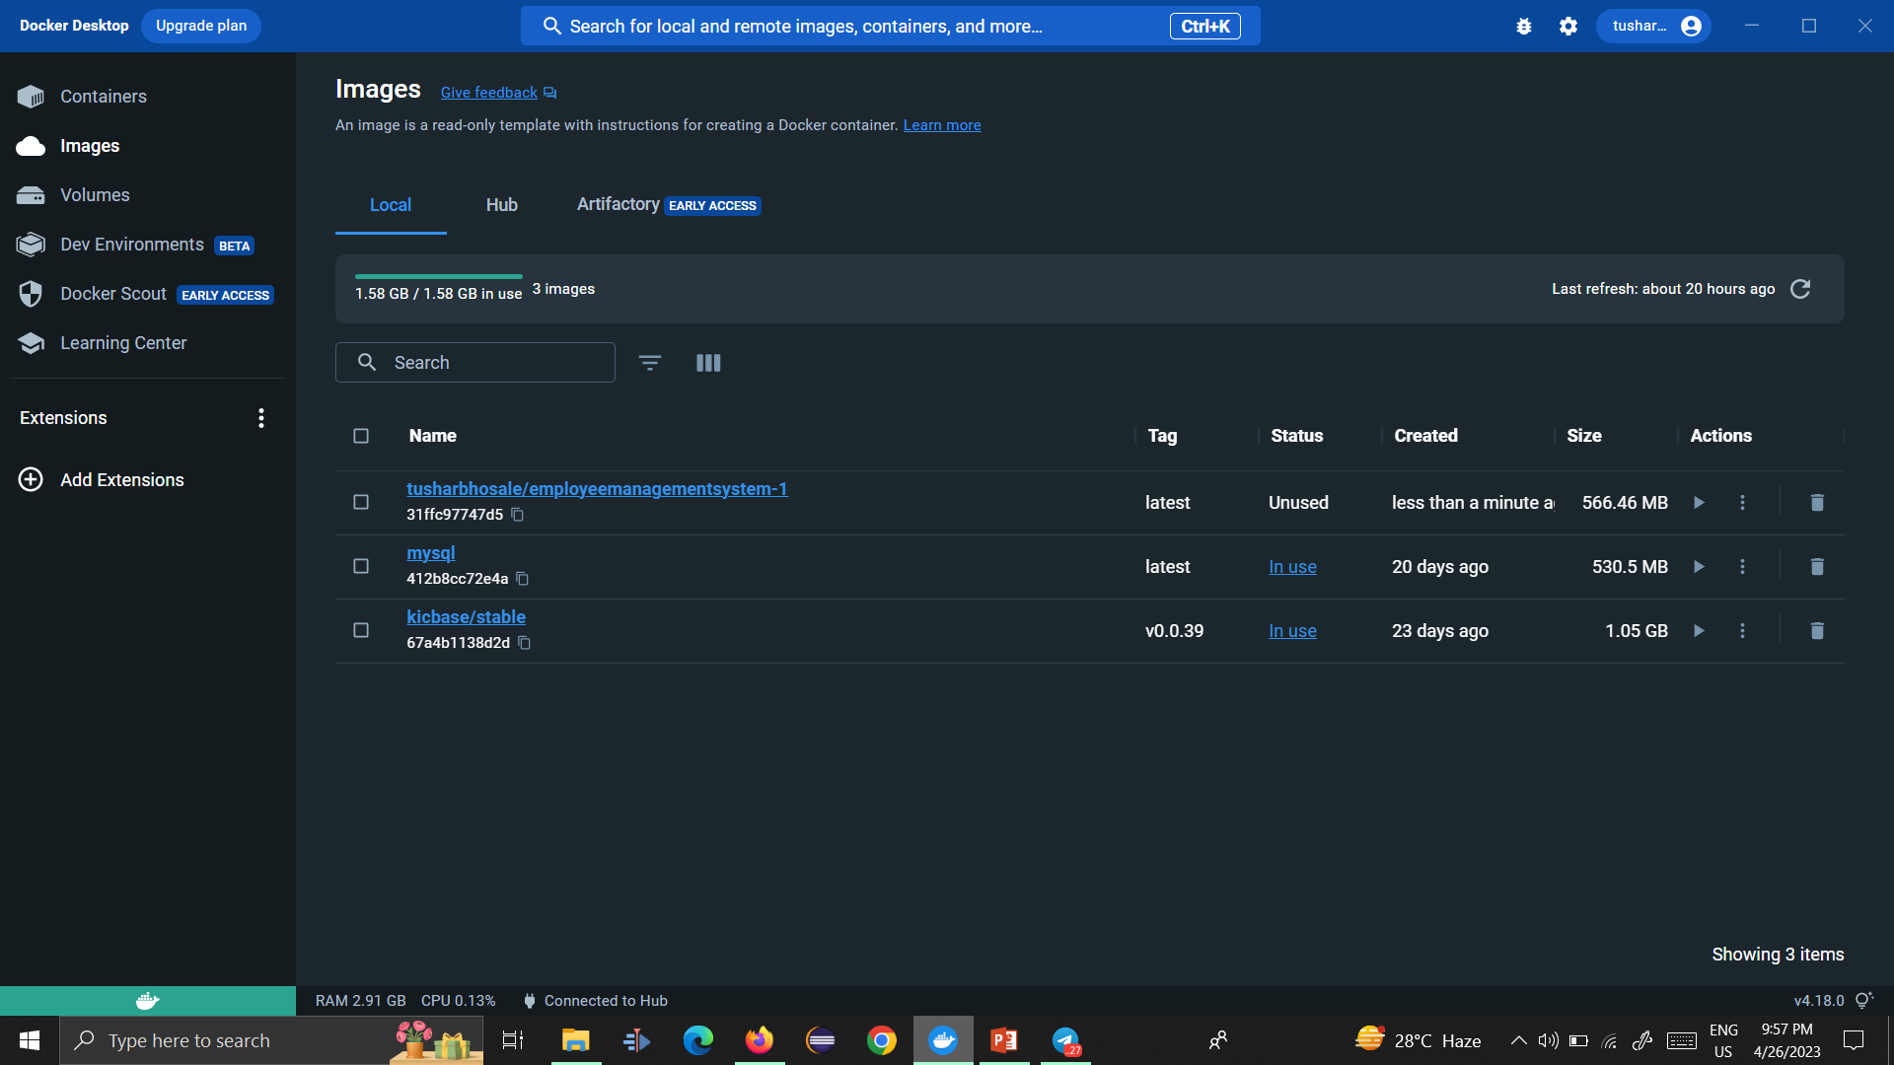
Deployment

Slide 11
Conclusion
In conclusion, the Employee Management System project was a success, achieving all of its objectives within the project's scope. We developed a robust back-end system using Spring Boot and Java, integrated with a MySQL database and encrypted sensitive data such as the date of birth. We implemented a RESTful API architecture, ensuring secure communication over HTTPS, and integrated the system with Kubernetes for deployment and scaling.
During the development process, we encountered some challenges related to performance and security. We addressed these challenges by implementing caching mechanisms, optimizing database queries, and using the latest security standards and encryption methods.
We learned many valuable lessons from this project, such as the importance of using design patterns and best practices for system architecture, and the need to continuously monitor and optimize system performance and security. These lessons can be applied to future projects to ensure their success.
In the future, we plan to add more features to the Employee Management System, such as support for multiple languages, enhanced reporting, and user management. We will also focus on improving system performance and scalability to handle increasing user loads.
Overall, the Employee Management System project has been a great success, providing a secure and scalable solution for managing employee data. We are proud of what we have achieved and are excited about the potential for future work and improvement.

Slide 12
Future Work
While the Employee Management System project has been successful in achieving its objectives, there are still opportunities for future work to enhance the system's functionality, performance, and security. Some of the potential areas for future work include:
Additional Features: In the future, we could add support for multiple languages to make the system more accessible to a wider range of users. We could also enhance the reporting capabilities to provide more detailed insights into employee data, and implement user management to enable different levels of access for different users.
Performance and Scalability: As the number of users and the amount of employee data grows, we will need to focus on optimizing the system's performance and scalability. This could involve implementing load balancing mechanisms, using caching mechanisms to reduce database queries, or upgrading hardware resources.
Security Enhancements: We will continue to monitor and enhance the system's security to protect sensitive employee data. Some potential enhancements could include implementing multi-factor authentication, regularly conducting security audits, or using more advanced encryption methods.
Integration with other systems: To enhance the system's functionality and provide a more seamless user experience, we could integrate the system with other HR management systems, payroll systems, or attendance tracking systems.
User Feedback: We will continue to gather feedback from users and stakeholders to identify areas for improvement and to ensure that the system meets their needs. Based on this feedback, we may make changes to the system's design or functionality.
Technology Upgrades: As new technologies and frameworks become available, we may explore the potential for upgrading the system's technologies. This could involve upgrading to newer versions of Spring Boot, using a different database, or exploring new programming languages and frameworks.
Testing and Quality Assurance: We will continue to focus on testing and quality assurance to ensure that the system is reliable, secure, and bug-free. This could involve implementing automated testing or conducting more comprehensive testing to identify and resolve issues more quickly.

Slide 13
Referance
Spring Boot documentation: https://spring.io/projects/spring-boot
Java Cryptography Architecture (JCA) documentation: https://docs.oracle.com/en/java/javase/16/security/java-cryptography-architecture-jca-reference-guide.html
Kubernetes documentation: https://kubernetes.io/docs/home/
Docker documentation: https://docs.docker.com/
Jenkins documentation: https://www.jenkins.io/doc/
JUnit documentation: https://junit.org/junit5/docs/current/user-guide/
Oracle Java SE documentation: https://docs.oracle.com/en/java/javase/index.html

